Slide 1
Machine Learning for Quantum Materials, Models, and Algorithms
Speaker: Yi Zhang (张亿)
frankzhangyi@pku.edu.cn
ICQM & School of Physics, Peking University
Artificial Intelligence for Theoretical Sciences Workshop, 11/13/2024

Slide 2
What is and why machine learning?

Slide 3

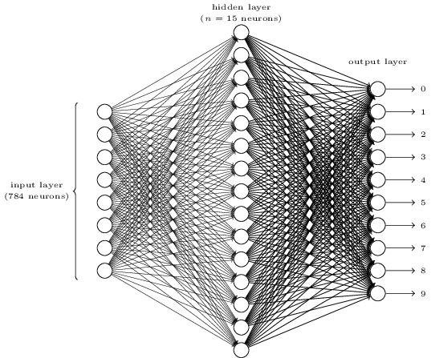
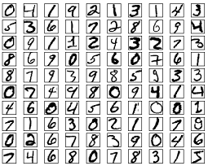
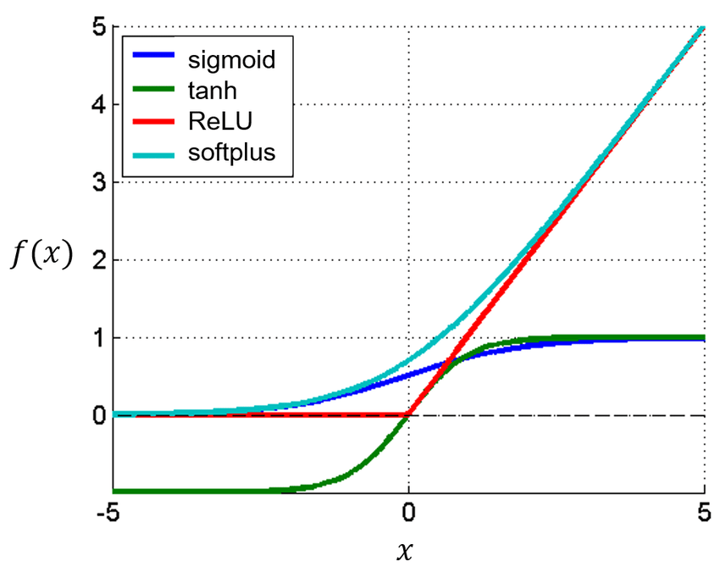





What is machine learning?
A new perspective of ‘programming’
E.g.: Image (hand-written digit) recognition
Conventional programming: Machine learning:
From linear regression to AlphaGo and ChatGPT:
Powerful expressions from nonlinear activation functions
w·x+b
Efficient optimizations from feed-forward architectures
Online book: http://neuralnetworksanddeeplearning.com/

Slide 4

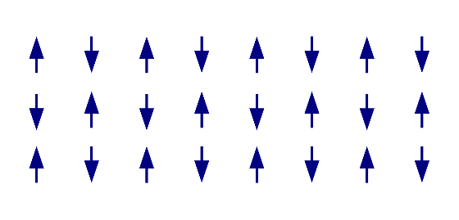
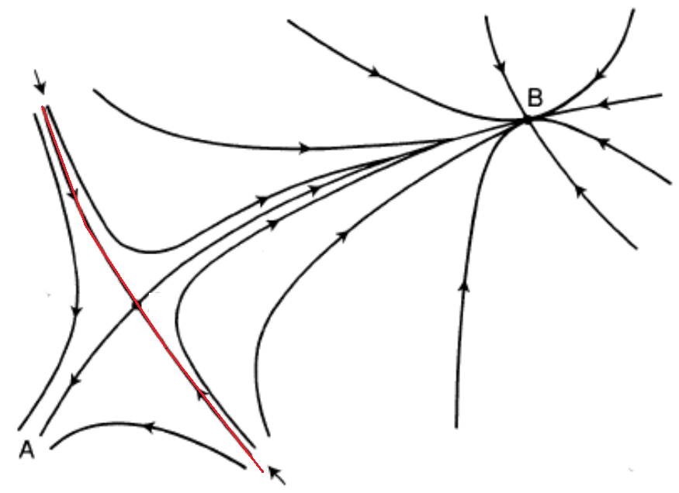
Why machine learning?
Image recognition versus condensed matter and quantum many-body physics
“Phase diagram” of hand-written digits:
Universality of macroscopic behaviors
Numerous microscopic d.o.f.
Emergence – “More is different.”
Flower
pixel
Antiferromagnet
spin
“2”
1:
…
2:
…
“1”
3:
…

Slide 5

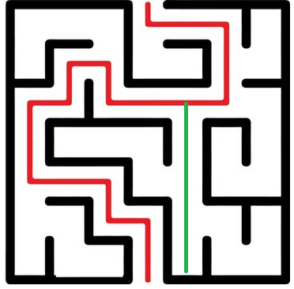
Why machine learning?
Advantages we have learned from the image-recognition problem, etc.:
Rules hidden or too abstract
Noise and fluctuation-ridden data
Efficiency and automation for large data
A “good enough” solution
Reverse thinking and new perspectives
“2”
“1”
Spherical cow approximation may not work all the time.
Solving a maze from the exit

Slide 6
Machine learning quantum models and materials

Slide 7
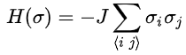
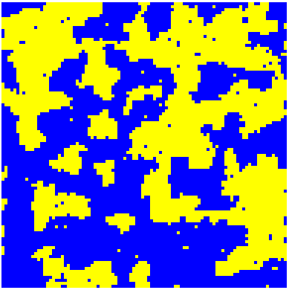
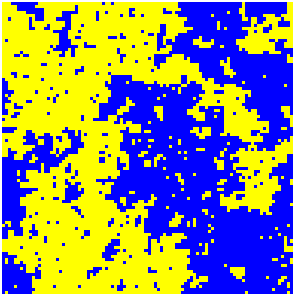
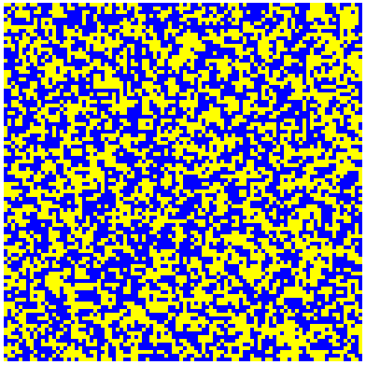
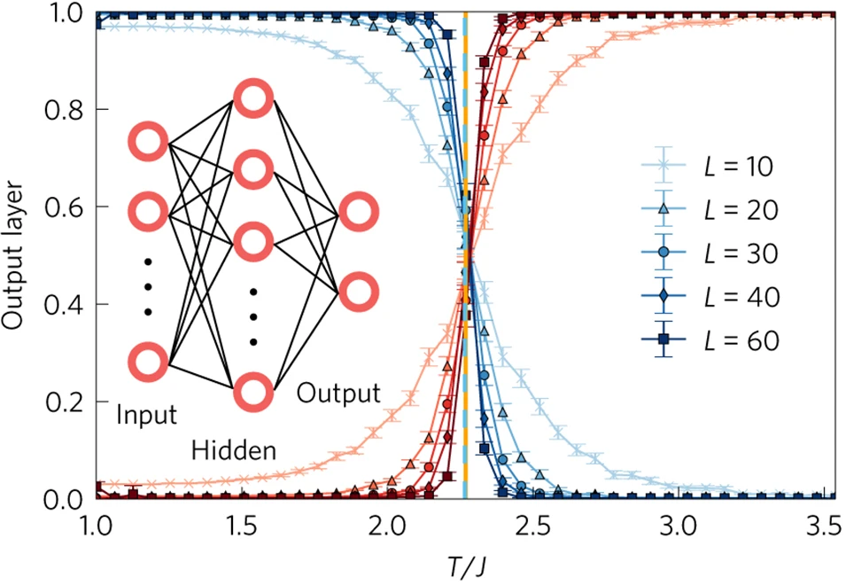
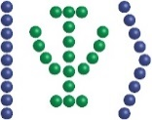

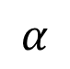
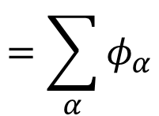
Machine learning phases of matter
2D Ising model
with (classical) Monte Carlo samples as machine-learning inputs:
However,
quantum states are different:
$$α$$
$$=\sum_{α}{φ_{α}}$$
Quantum many-body state
1. Measurables 2. Operators
Machine learning
Juan Carrasquilla, Roger G. Melko, Nature Physics 13, 431–434 (2017).

Slide 8
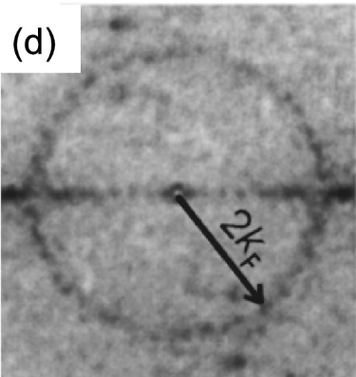
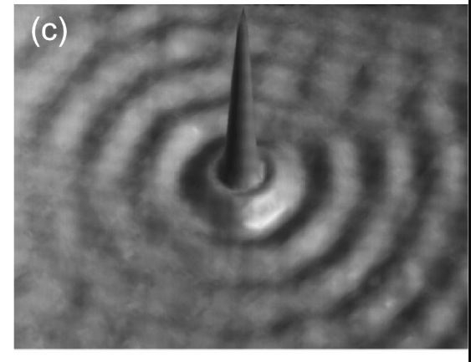
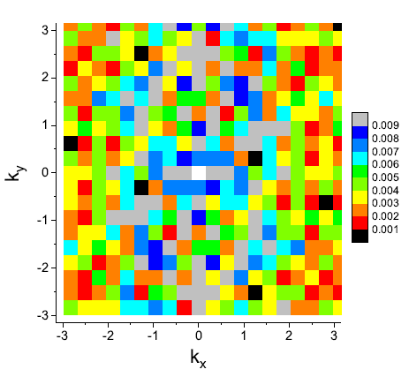
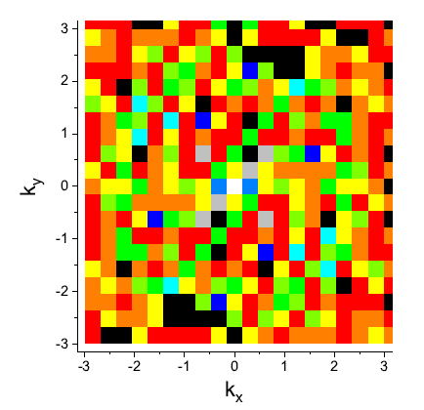
STM data of Electron Quantum Matter
Quasiparticle interference characterizes electron Fermi surfaces
However:
Noises and fluctuations
Large impurity density
Small field of view, etc.
Pierre Mallet, et al., Comptes Rendus Physique 17, 294 (2016).
STM image
Fourier transform
experiments
explanatory theory

Slide 9

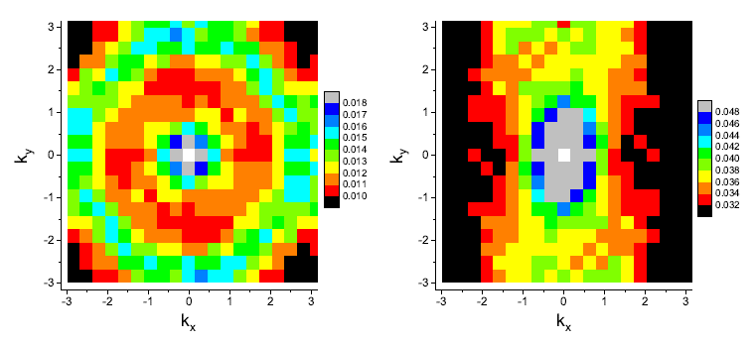
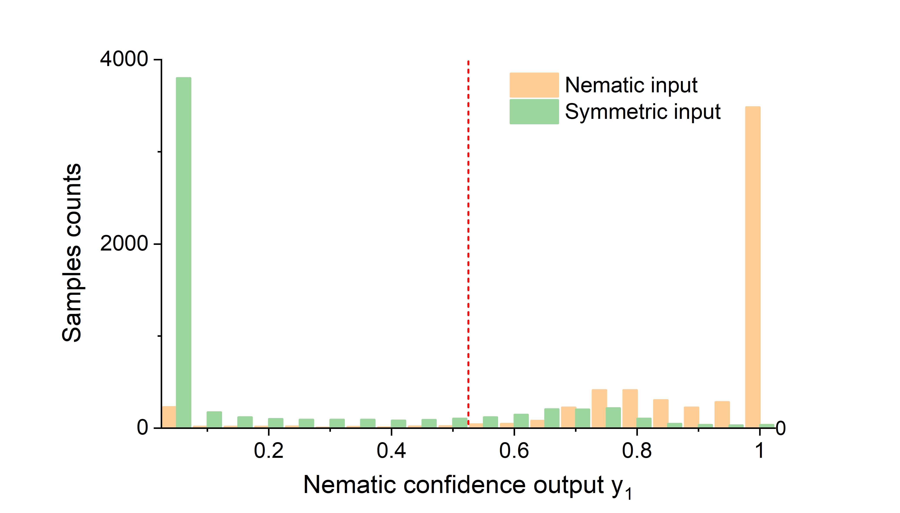
Machine learning EQM STM data
Q: is the information fully lost? A: Maybe, maybe not.
symmetric phase versus nematic phase
experiments
explanatory theory
Machine learning models
trained with the noisy data, trained for the noisy data (>95% accuracy)
averaged over 1000 FOVs
Info still there, analysis lacking
Jeremy B. Goetz, YZ*, M. J. Lawler, SciPost Phys. 8, 087 (2020).

Slide 10
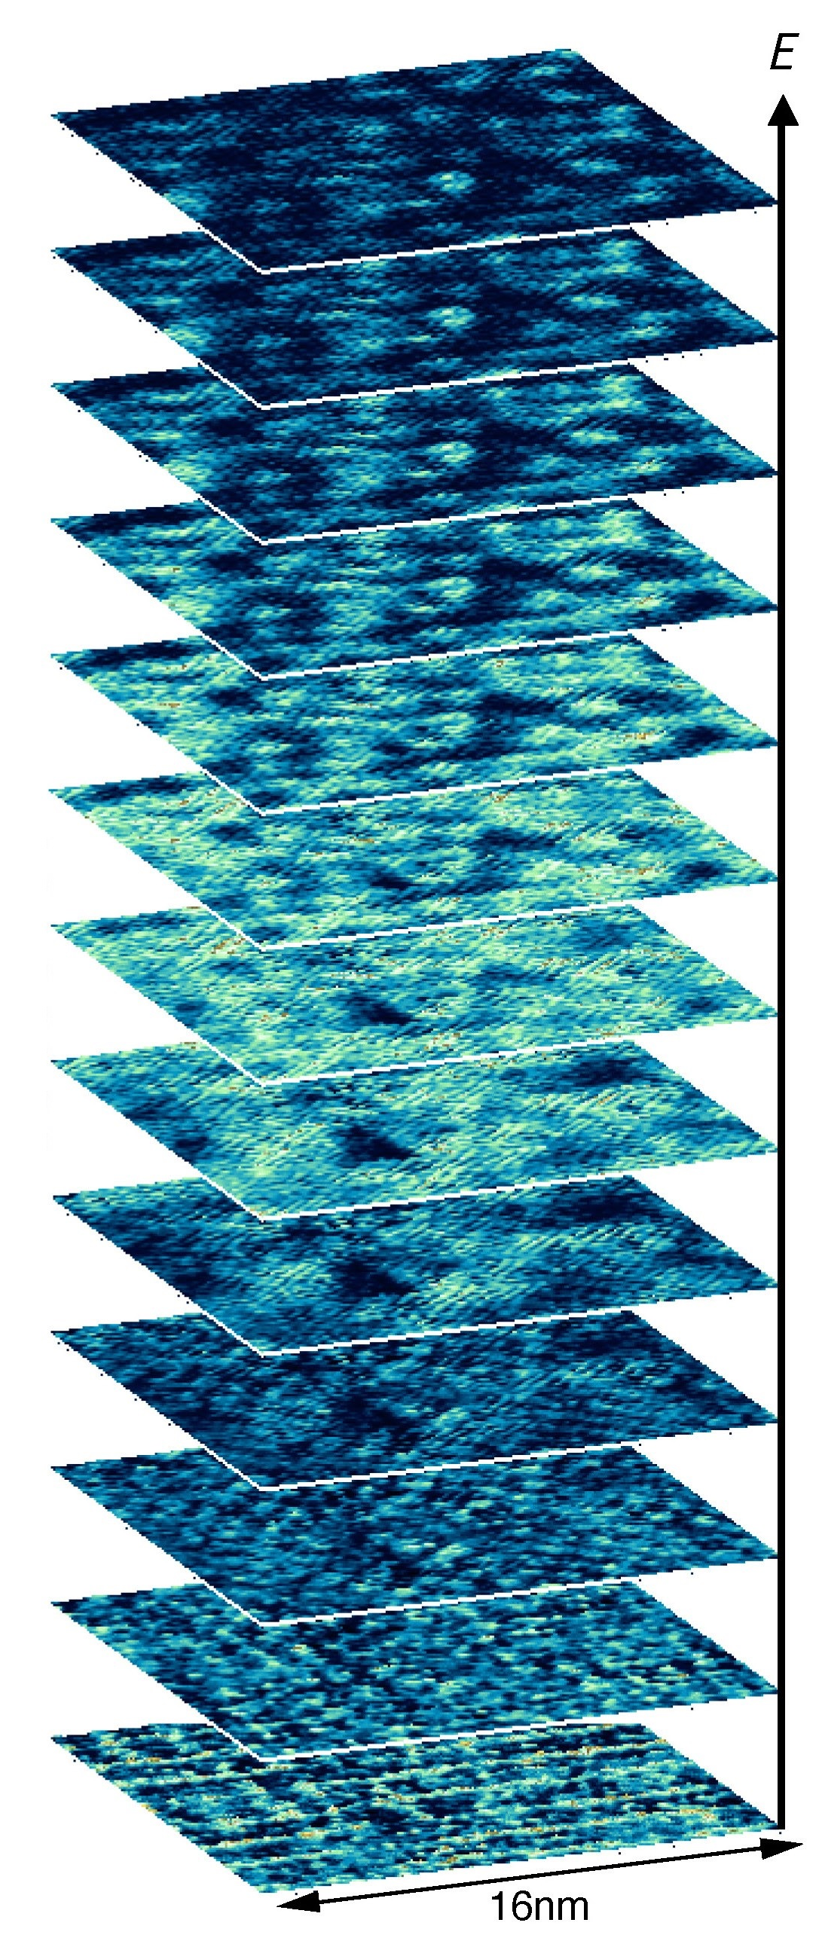
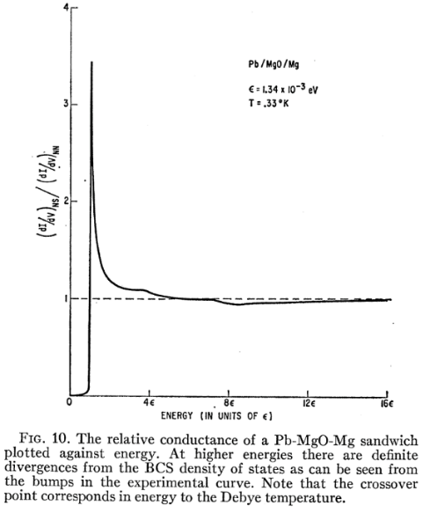
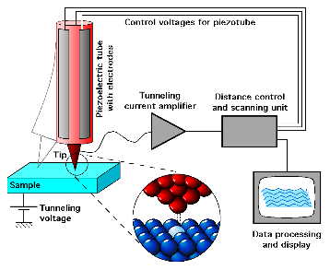
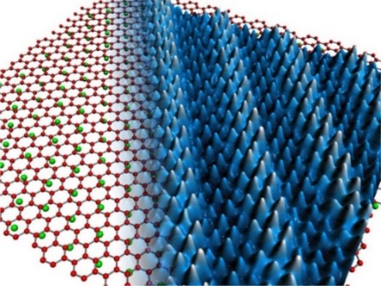
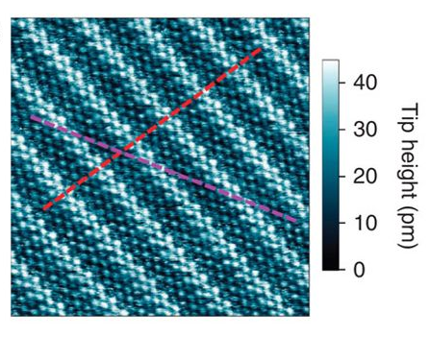
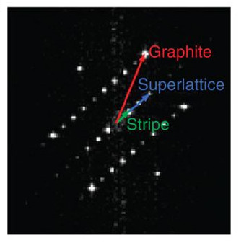
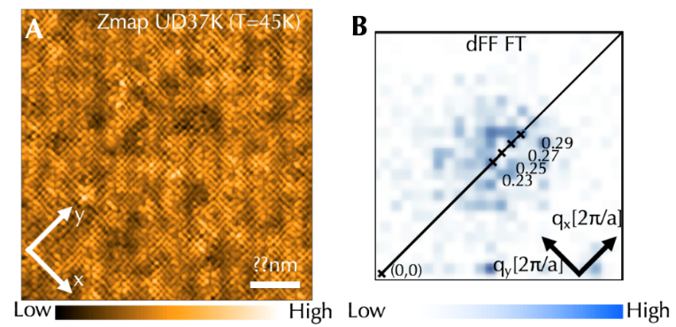
STM large data of Quantum Matter
The large-data problem
From to
The noisy-data problem
Giaever et al.,
Phys. Rev. 126, 941 (1962).
Fourier transform:
e.g., the pattern of charge order
STM image and Fourier transform of CaC₆ versus BSCCO
K.C. Rahnejat, C.A. Howard, et al., Nature Communications 2, 558 (2011).

Slide 11
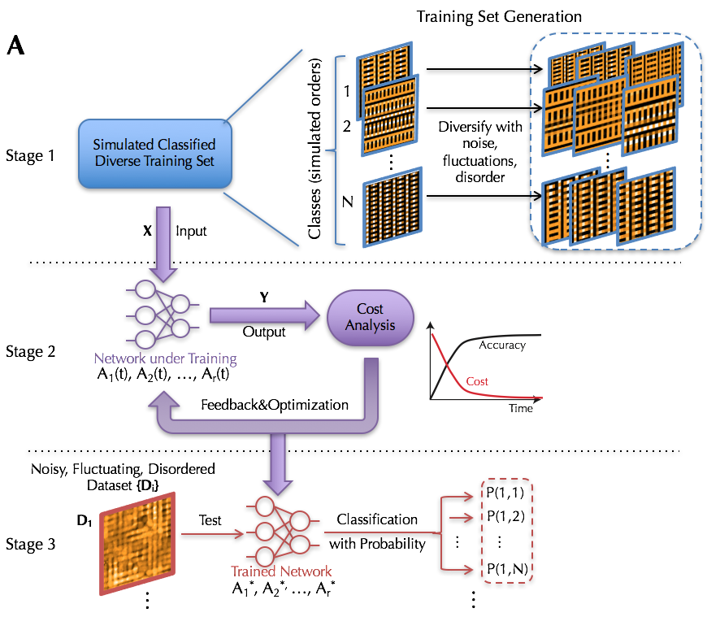
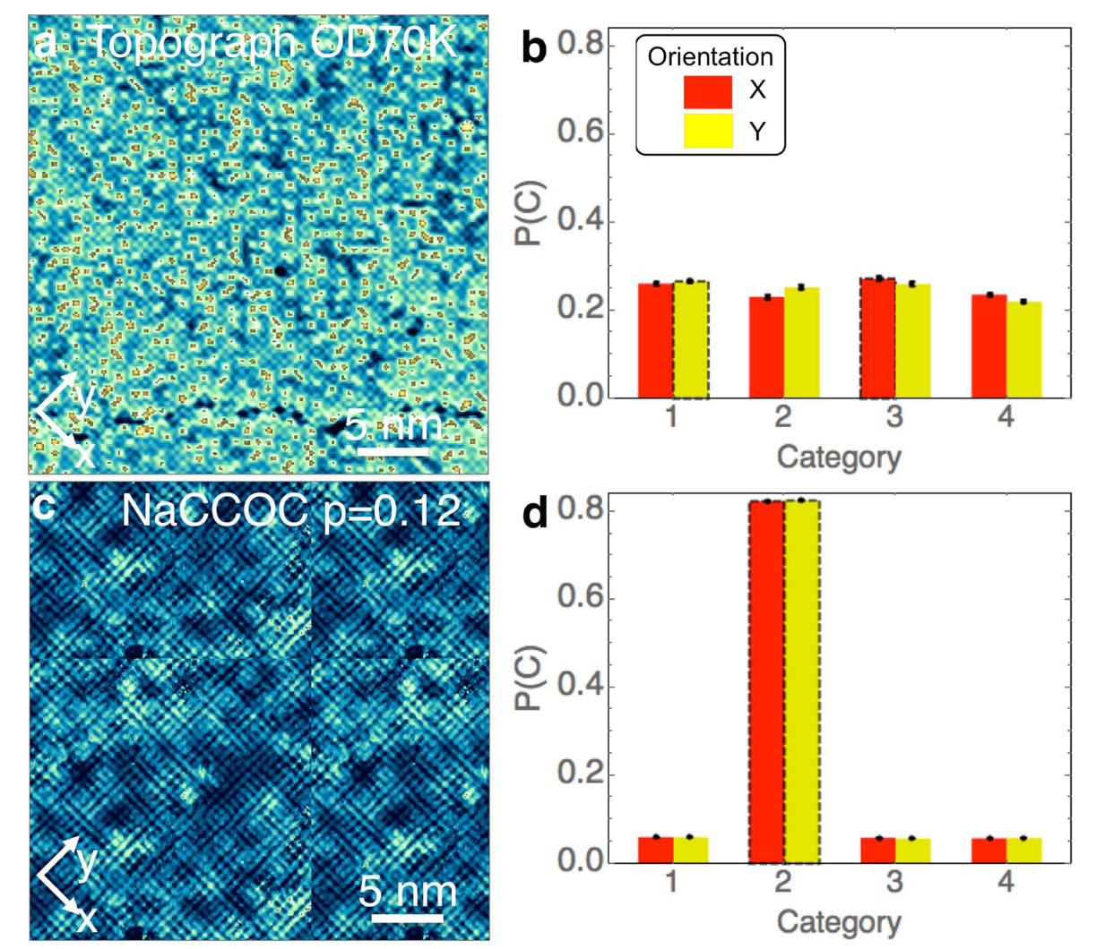

Machine learning EQM STM data
Bridging theories and experimental data with machine learning
Similar formalism applied to other large experimental data, e.g., neutron scattering data
experiments
explanatory theory
Machine learning models
$4a_{0}$ stripe charge order
Anjana M. Samarakoon, et al.,Nature Communications 11, 892 (2020).
YZ†, Andrej Mesaros†, et al., Nature 570, 484–490 (2019).

Slide 12
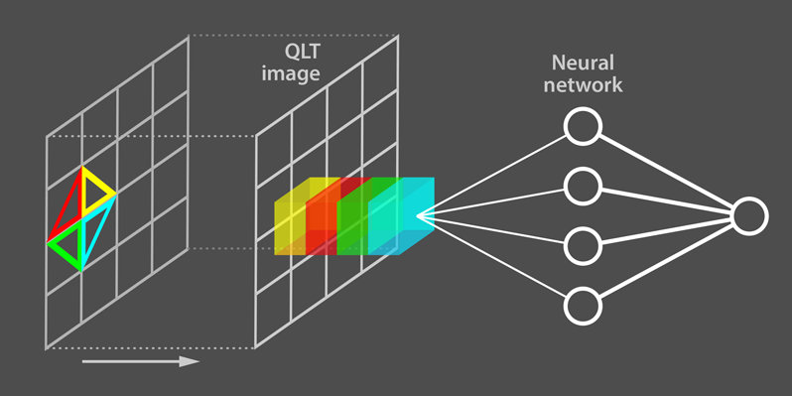
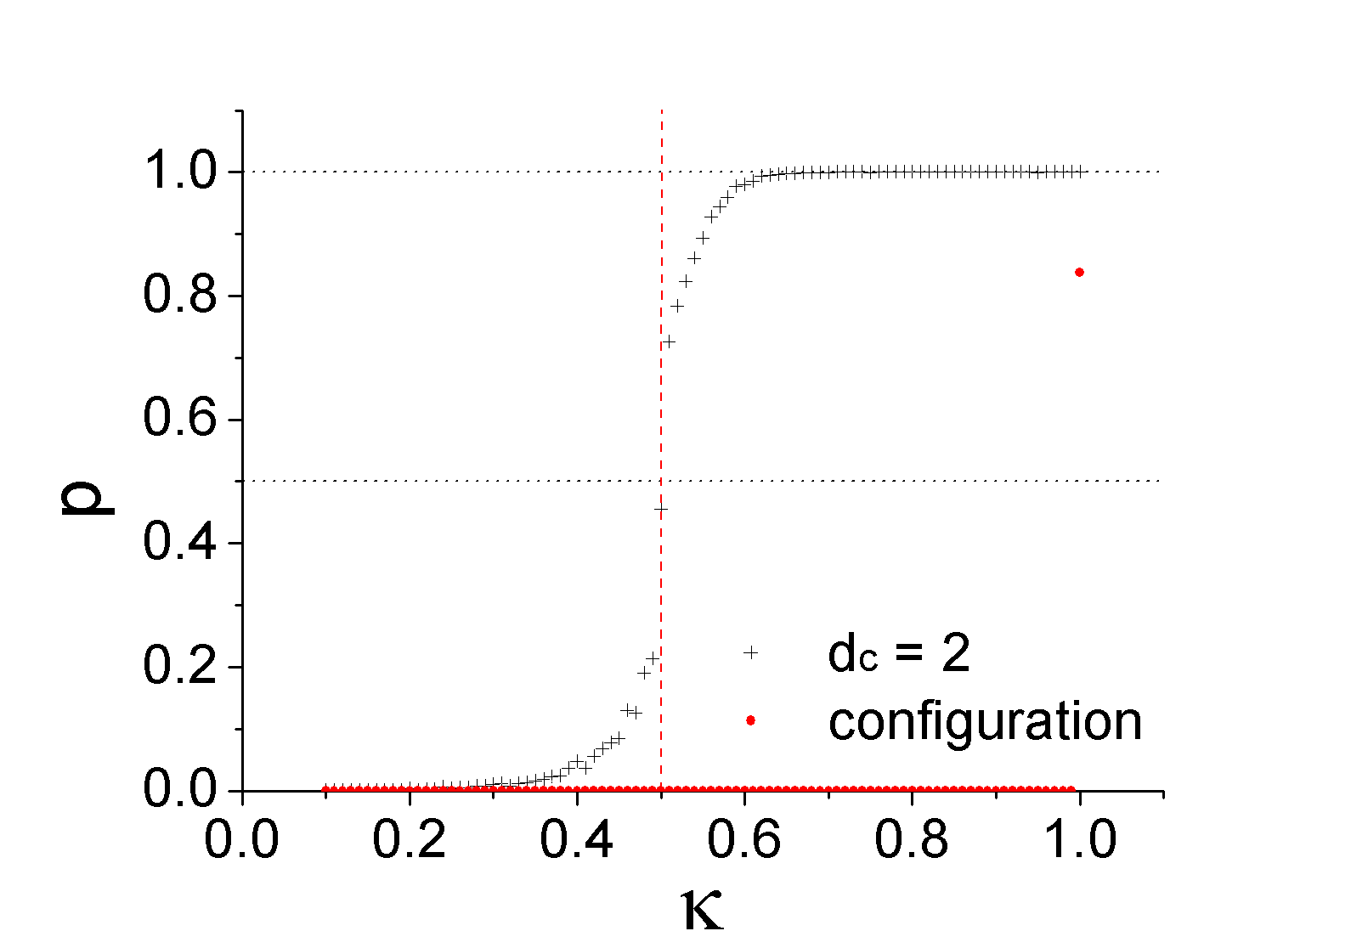
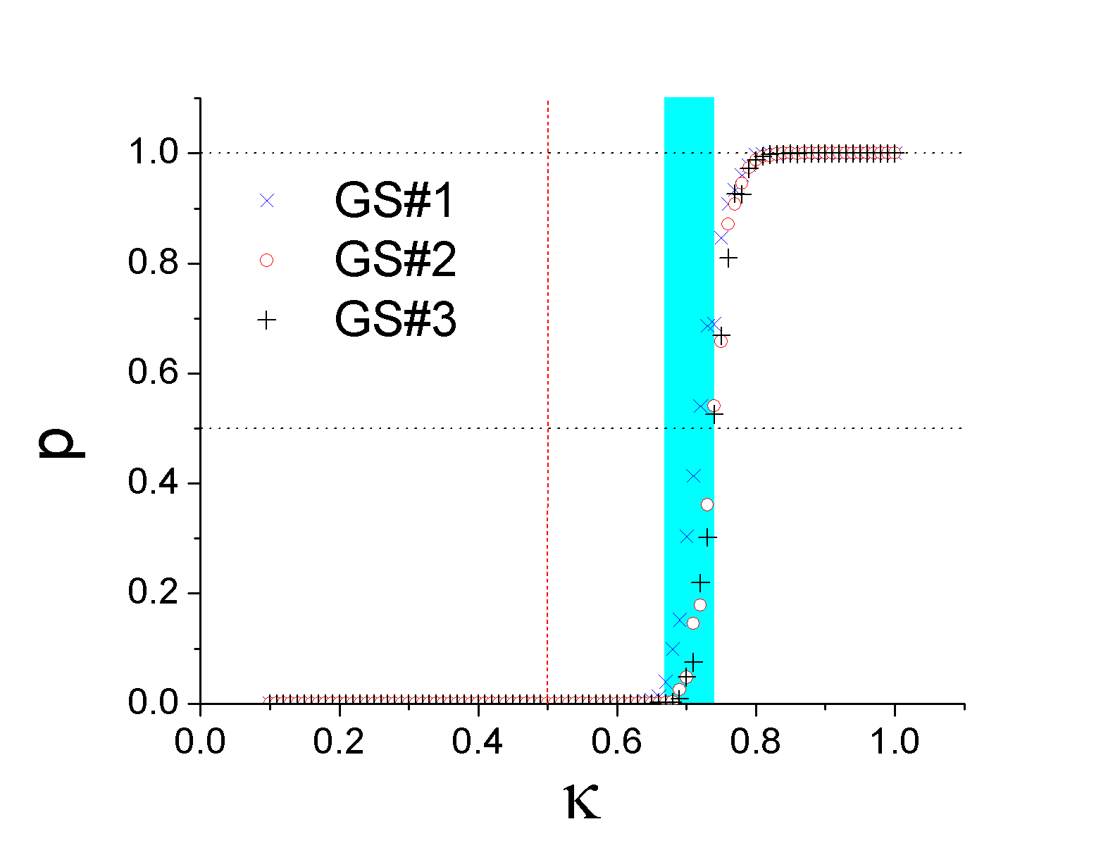
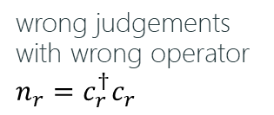
Machine learning quantum models
Preprocessing information from quantum many-body states with operators
Alan Stonebraker, Physics Viewpoint
Quantum states
‘Informative’ operators
Machine learning algorithm
Interpret the guiding principles
Results:
Normal insulator
QH insulator
Normal insulator
Fractional
QH insulator
wrong judgements with wrong operator
$$n_{r}=c_{r}^{†}c_{r}$$
YZ*, E.-A. Kim*, Phys. Rev. Lett. 118, 216401 (2017), Editor’s Suggestions and Viewpoint.

Slide 13
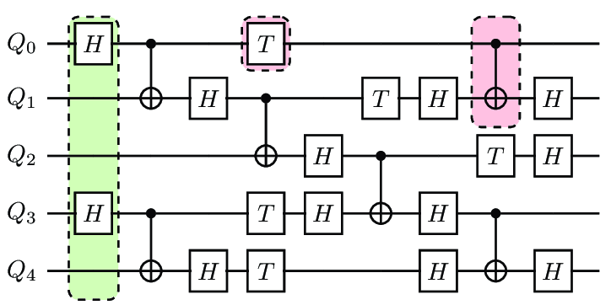
Machine learning quantum models
(Quantum?) machine learning with quantum models and for quantum models
Issues with quantum (circuits) neural networks
- Lack of efficient, collective optimization
- Limited expression due to linearity
Data Method | Classical | Quantum
Classical | Classical ML | Previous
Quantum
Quantum adaptiveness
- without presumptions
- without bridging
Quantum advantages?

Slide 14
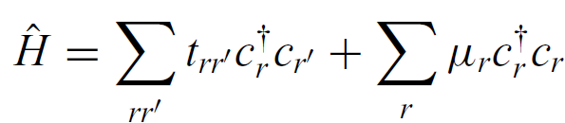
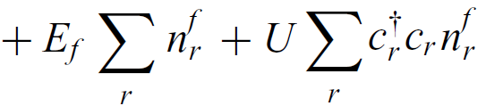
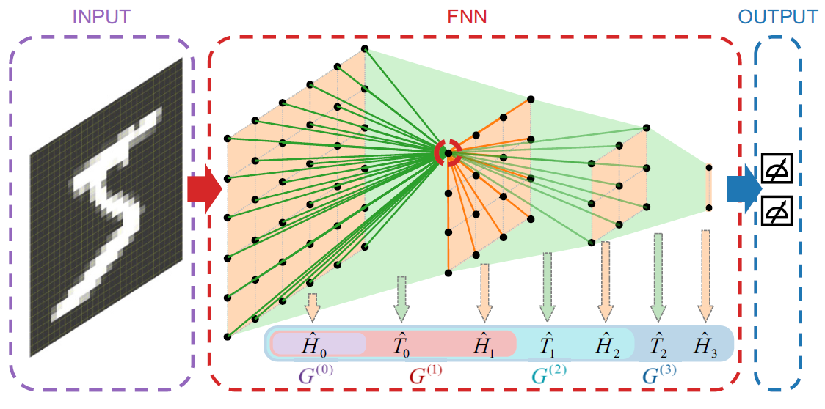
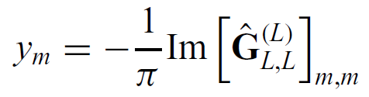
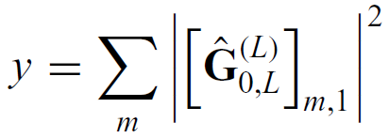
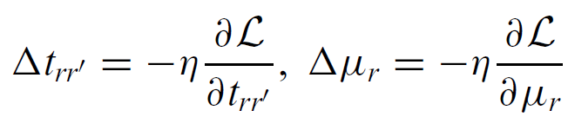
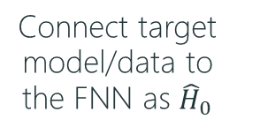
Machine learning with fermion networks
A fermion model for machine learning: (potential interactions)
Input: model parameters Output:
Training with gradient descent:
Connect target model/data to the FNN as ${\hat{H}}_{0}$
Physical properties of the total system
LDOS over last layer:
or localization across depth:
Machine learning formalism

Slide 15
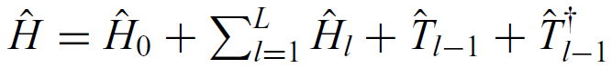
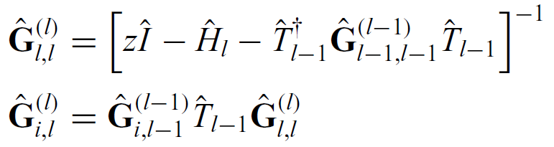

Back-propagation with Greens functions
Non-linear expressions and efficient optimizations:
layered architecture
Feed-forward: layer 0 to layer L for efficient output
Back-propagation: layer L to layer 0 for collective gradients
compared with feed-forward ANNs:
Recursive Greens function for performance

Slide 16
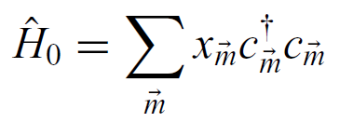
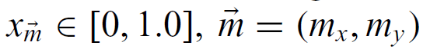
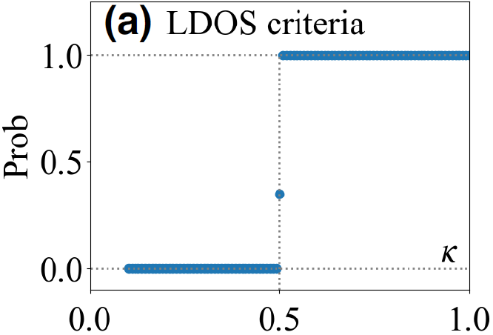
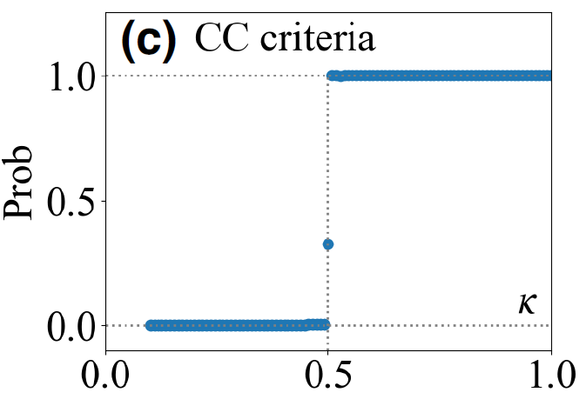
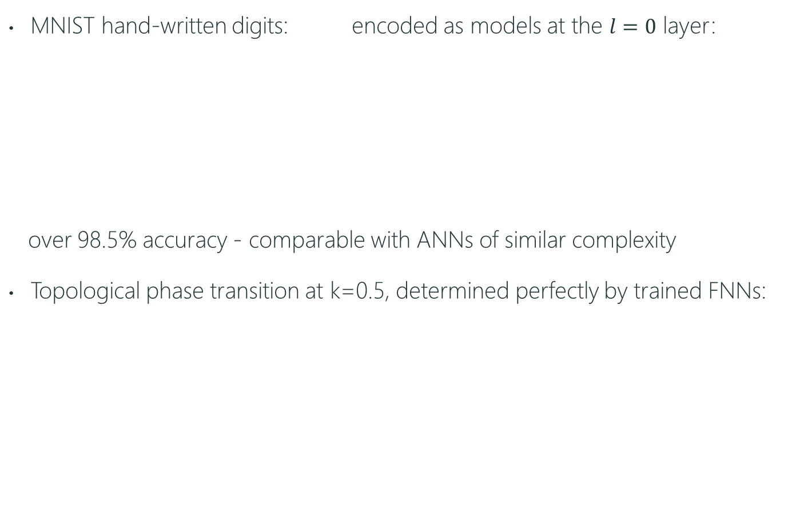
Application on classical & quantum data
MNIST hand-written digits: encoded as models at the $l=0$ layer:
over 98.5% accuracy - comparable with ANNs of similar complexity
Topological phase transition at k=0.5, determined perfectly by trained FNNs:
(as well as other encoding models)
in-situ mapping of elusive target properties to more straightforward quantities
No presumptions or pre-processing for characterization
Pei-Lin Zheng, Jia-Bao Wang, Yi Zhang*, Phys. Rev. Applied 20, 044002 (2023)[Editors' Suggestion].

Slide 17
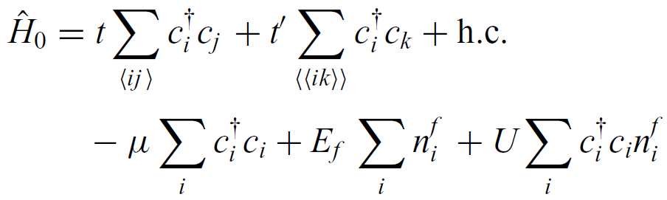
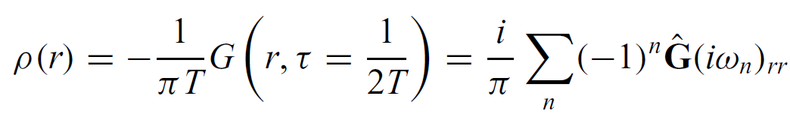


Machine learning complex quantum system
The 2D Falicov-Kimbal (FK) model: itinerant electrons
localized electrons
Machine learning with respect to Matsubara Greens functions:
E.g. LDOS:
DMFT for quantum many-body systems
hard target system
overall system with higher dimensions and coordination numbers

Slide 18
Machine learning for quantum algorithms

Slide 19





Machine learning for quantum compiling
Given a universal set of unitary gates, we can
e.g., braiding topological quasiparticles:
build any target unitary through a sequence $U≈U_{1}^{n_{1}}U_{2}^{n_{2}}U_{1}^{n_{3}}U_{2}^{n_{4}}⋯$.
The hard part: find a sequence as short and fast as possible and express the target unitary as precise as possible
Practical approaches have either bad time complexity (brute-force) or length complexity (Lie group generators)
$$U_{1}$$
$$U_{2}$$
Chetan Nayak, et al., Rev. Mod. Phys. 80, 1083 (2008).
Similarity between quantum compiling and Rubik’s cube:

Slide 20








Machine learning for quantum compiling
With reinforcement learning and (weighted) A* search method:
$s→s^{′}→s′′→⋯→$ target
Results: (by-far more efficient and good enough)
for selected target unitaries: improved length and time complexity:
$s$: state (e.g. game board of GO);
$a$: action (e.g., next stone in GO);
$$a$$
$$a’$$
$$a’’$$
ANN
the sequence length
Yuan-Hang Zhang, Pei-Lin Zheng, YZ*, and D.-L. Deng*, Phys. Rev. Lett. 125, 170501 (2021).

Slide 21
















Machine learning quantum bootstraps
We wish to go from: quantum models to: ground-state properties
e.g., does the Hubbard model have a superconducting ground state?
order parameters
Conventional:
Now, we can minimize $E=\left\langle \hat{H}\right\rangle =\sum_{i}{c_{i}\left\langle {\hat{O}}_{i}\right\rangle }$ under quantum bootstraps:
Machine learning
$$H$$
$$|Φ_{GS}⟩$$
$${\left\langle {\hat{O}}_{j}\right\rangle }_{GS}$$
$${\left|Φ\right\rangle }_{1}$$
$${\left\langle {\hat{O}}_{j}\right\rangle }_{1}$$
$${\left|Φ\right\rangle }_{2}$$
$${\left\langle {\hat{O}}_{j}\right\rangle }_{2}$$
$${\hat{H}}_{1} =a_{j}{\hat{O}}_{j}$$
$${\left|Φ\right\rangle }_{3}$$
$${\left\langle {\hat{O}}_{j}\right\rangle }_{3}$$
$$f_{ANN}(\left\langle {\hat{O}}_{j}\right\rangle )$$
$${\hat{H}}_{2} =a_{j}^{′}{\hat{O}}_{j}$$
…
……
$${\left|Φ\right\rangle }_{N}$$
$${\left\langle {\hat{O}}_{j}\right\rangle }_{N}$$

Slide 22



Machine learning quantum bootstraps
Applications on interacting fermion and spin chains:
with quantum bootstraps trained with:
free fermion states iMPS and VMC
Results: ground-state energy @
$$\hat{H}=\sum_{x}{−t\left(c_{x+1}^{†}c_{x}+h.c.\right)+Vc_{x+1}^{†}c_{x+1}c_{x}^{†}c_{x}}$$
$$\hat{H}=\sum_{j}{−JS_{j}^{z}S_{j+1}^{z}−gS_{j}^{x}−hS_{j}^{z}}$$
$$\min_{g_{r},{\tilde{g}}_{r^{′}}}{ L=\overline{E}+ηf or \overline{E}+ηf^{∗} }$$
Pei-Lin Zheng, Si-Jing Du, YZ*, Phys. Rev. Research 4, L032043 (2022).

Slide 23







Summary
Example of machine learning on quantum phases and quantum algorithms
Machine learning large and noisy experimental and numerical data
Efficient and quantum compatible quantum-model machine learning
Reinforcement learning for quantum compiling
Machine learning quantum bootstraps for ground-state properties
Preliminary interpretability and controllability
Acknowledgment:
M. J. Lawler
Andrej Mesaros
Yuan-Hang Zhang
Dong-Ling Deng
Pei-Lin Zheng PKU
Si-Jing Du PKU to Caltech
Jia-bao Wang PKU
Eun-Ah Kim
Cornell Univ.
Paul Ginsparg
Cornell Univ.
Email: frankzhangyi@pku.edu.cn; frankzhangyi@gmail.com

Slide 24

Email: frankzhangyi@pku.edu.cn

